Slide 1


Putting industry in the driving seat for biotrade growth: Panel discussion with SDP implementers
Sandra Kruger Kruger Swart Associates (KSA) 14 September 2023

Slide 2


Rational of
Sector Development Plans
Adrie El Mohamadi
ABioSA/BIA SA component manager
          Funder: Swiss state secretariate for econimic affairs (SECO)
          Implementer: Deutsche Gesellschaft für Internationale Zusammenarbeit (GIZ)
          Govt partner: Department of Forestry, Fisheries and the Environment (DFFE)
          Governance: ABS Capacity Development Innitiative

Slide 3
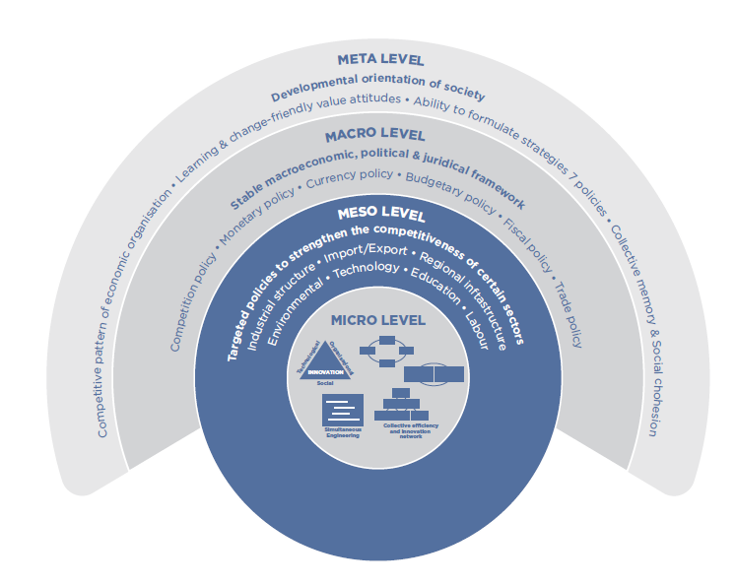
Systemic Competitiveness Approach
Notes:
Support the development of a resilient gender-responsive ABS-compliant southern African biotrade sector, through a systemic competitiveness approach to increase market access for value-added natural ingredients and products.
It is the level of competitiveness at all four these levels of the system and their interaction that generate a competitive advantage.
Competitiveness is systemic.

Slide 4


Role of Sector Development Plans
Notes:
Role of facilitation to move stakeholders in the same direction

Slide 5

Sector Development Plan Approach
Generate a short list of jointly agreed key strategic interventions
Should be concrete; action- and results-oriented activities with budget breakdown, owned by different stakeholders and institutions for implementation.
Establish a platform for future high-level government and industry engagements to address problems and resolve disputes.
Address “institutionalization” for governance, coordination, and accountability across the spectrum of responsible stakeholders.
Notes:
The snowball effect is a psychological term that explains how small actions can cause bigger and bigger actions, ultimately resulting in a big impact

Slide 6
Series of important events in South Africa (MACRO)
2004
National Environmental Management: Biodiversity Act (NEMBA)
2008
Bioprospecting, Access and Benefit Sharing (BABS) Regulations
2016
Operation Phakisa Lab on Biodiversity (BioPANZA)
2016
National Biodiversity Economy Strategy (NBES)
2018
Development of the first Master Plan under the dtic

Slide 7
Sector Development Process
Stakeholder mapping
Who is out there? Public & Private (MESO)
Facilitated sector plan development
Identify and agree on key areas/activities
Implementation support
Seed funding to support the kick-off
Ownership and accountability
Interaction/
networks between stakeholders (MESO)
What are the culture and beliefs (META)
Inclusive participatory process
Creating a platform for dialogue
Trust in the snowball effect
Crowding in additional funding
Peer learning sessions
50/50 (cash/in-kind)
2019 - 2020
2020 - 2021
2022

Slide 8
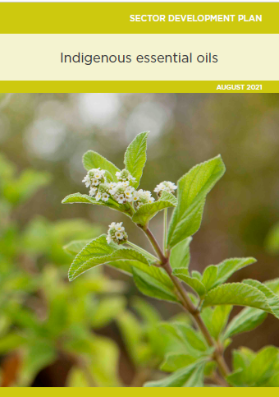
6 Sector Development Plans
                Aloe ferox
                Buchu
                Baobab
                Honeybush
                Marula
                Essential oil cluster
Notes:
Essential oil cluster: incl. Lippia javanica, Cape chamomile and Helichrysum.

Slide 9
SDP implementation

Slide 10
Panel discussion with SDP implementers

Slide 11
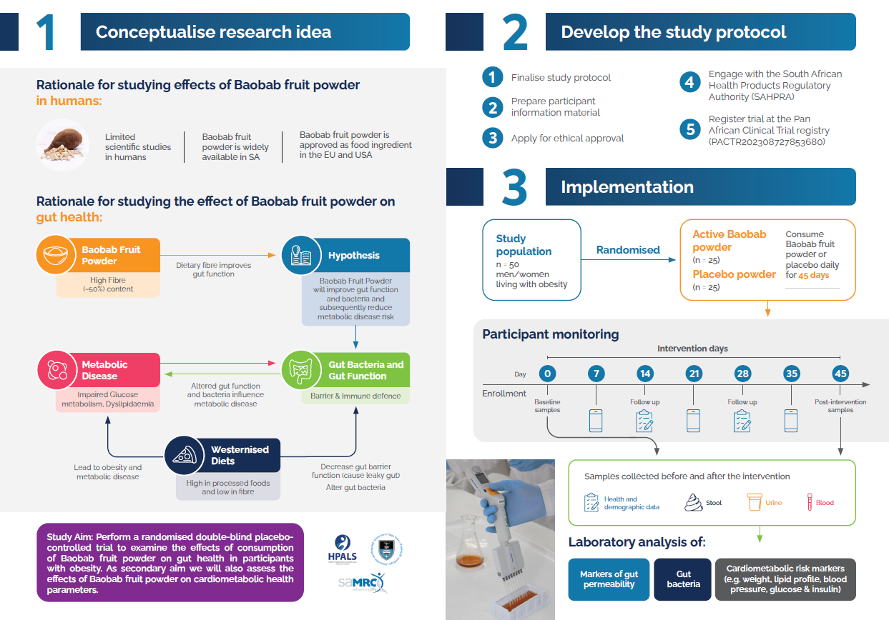

Slide 12
